Slide 1
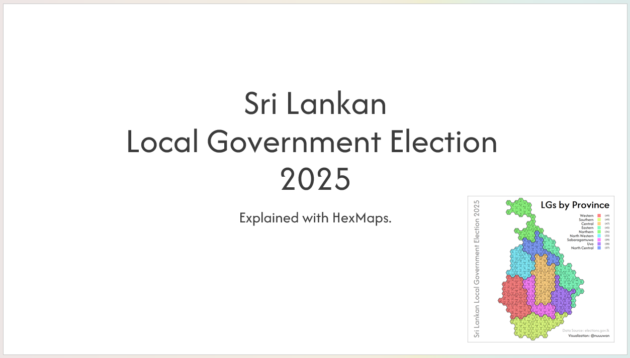
Notes:
Sri Lankan Local Government Election 2025 - Explained with HexMaps.

Slide 2
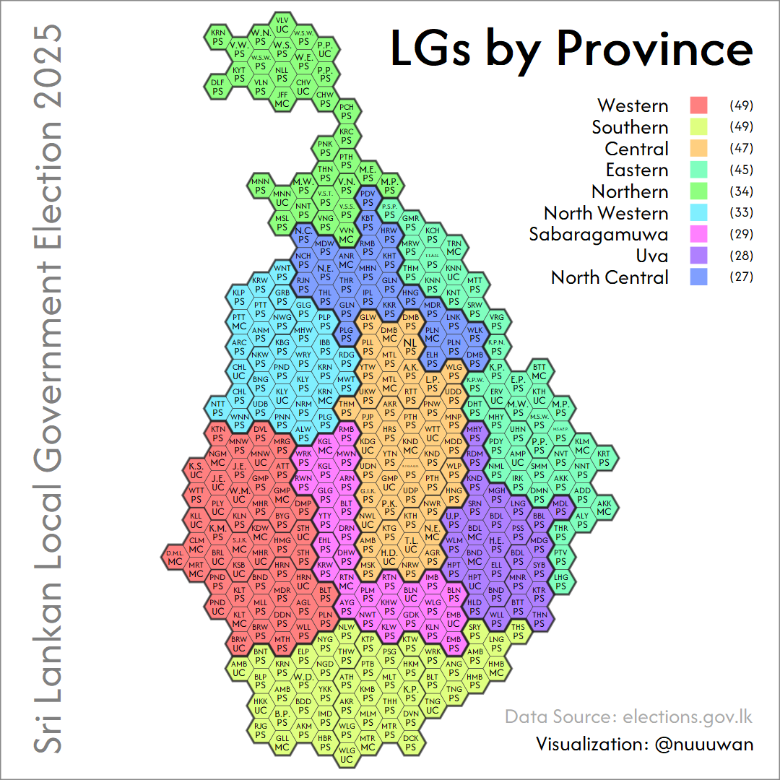
Notes:
A HexMap uses uniform hexagonal tiles to represent regions, maintaining geographic layout for clarity and comparability.
In this HexMap of Sri Lanka, each tile represents a Local Government area (LG), coloured by Province. Western and Southern Provinces have the most LGs (49 each), while North Central has the fewest (27).

Slide 3
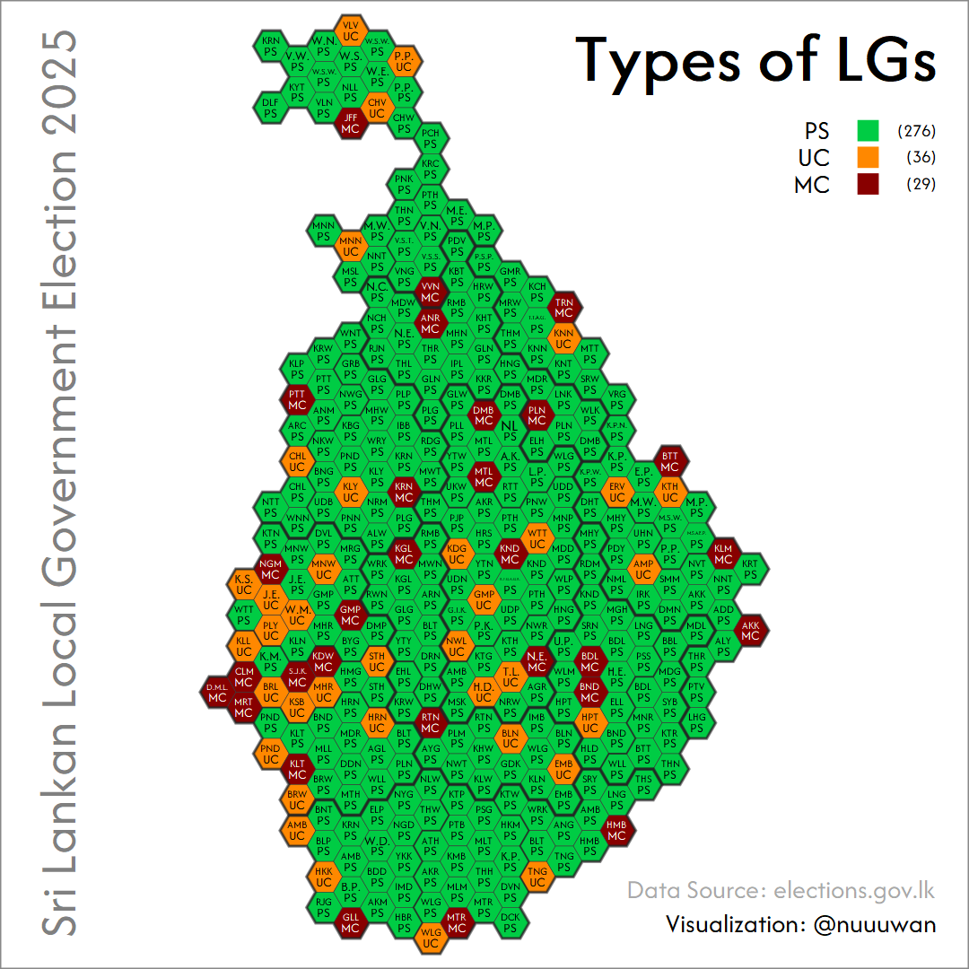
Notes:
Sri Lanka has 341 Local Authorities: 29 Municipal Councils (MCs), 26 Urban Councils (UCs), and 276 Pradeshiya Sabhas (PSs). This setup reflects the urban–rural divide - MCs govern major cities, UCs smaller towns, and PSs rural and semi-urban areas. They manage local infrastructure, public services, and community development under the Ministry of Local Government.
While the Colombo (CLM) MC is the largest LG in terms of electors (registered voters), MC are not necessarily larger populations than UCs or PSs. For example, the Kandy (KND) PS has more electors than the Kandy MC.
In general, the Western Province seems to have larger LGs (in terms of electors).
There are also significant differences in the number of electors per seats, with factor of 10 between the highest and the lowest.

Slide 4
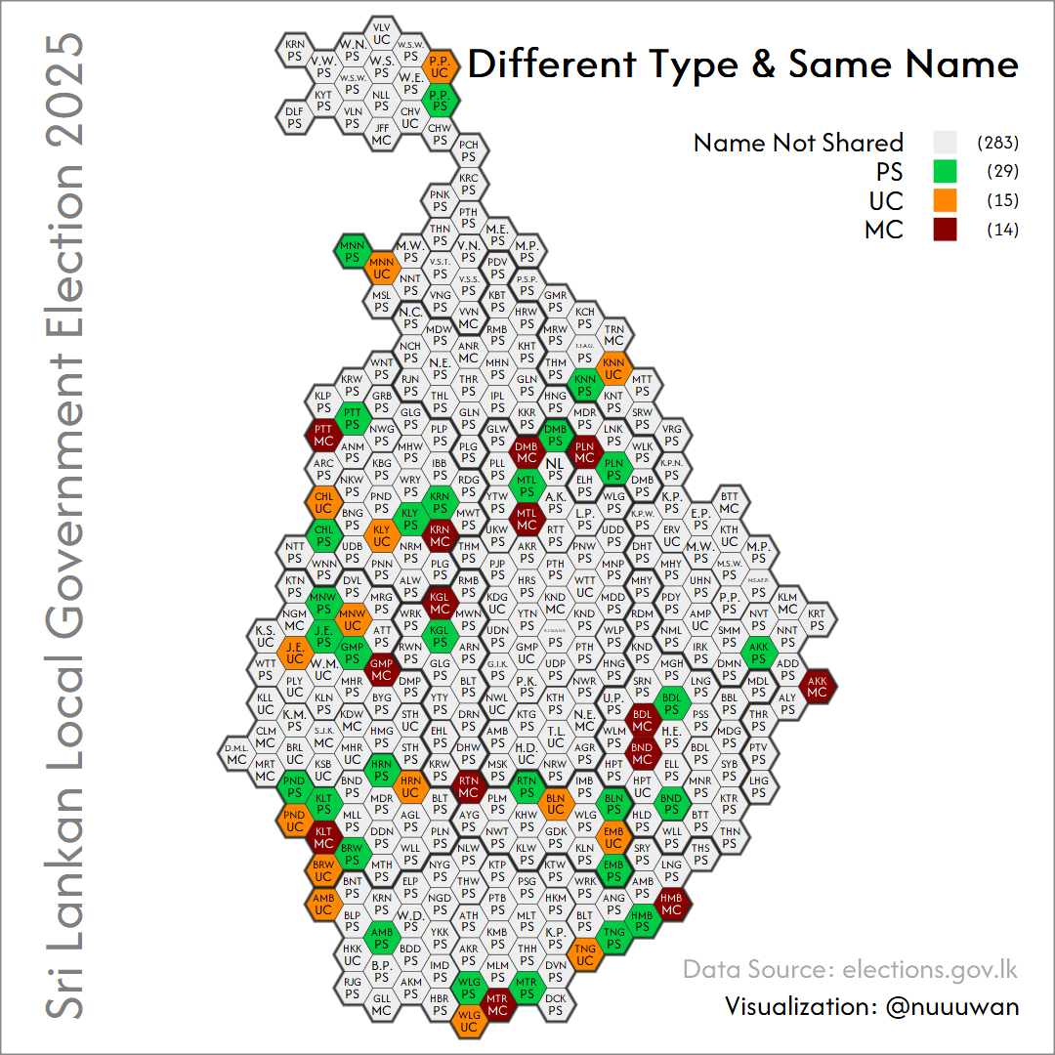
Notes:
In Sri Lanka, some local government areas share the same name but differ by type - e.g., Kalutara has both a Municipal Council (MC) and a Pradeshiya Sabha (PS).
This is due to the governance structure separating urban and rural areas: urban cores (cities or large towns) are managed by Municipal or Urban Councils (UCs), while surrounding rural\suburban zones fall under Pradeshiya Sabhas. This urban-rural split with shared names occurs in 29 areas nationwide.
339 LGs were contested in the 2025 Elections
Of the 341 Local Government (LG) bodies, 339 contested the 2025 Sri Lankan LG Election. Elpitiya PS and Kalmunai MC did not.
Elpitiya PS held an early election on 26 Oct 2024 after its council term ended in Mar 2024, following four budget rejections. A special commissioner administered it until then. The NPP won 15 of 30 seats, becoming the largest party.
Kalmunai MC was excluded due to a Supreme Court interim injunction. Two residents filed FR petitions claiming Sainthamaruthu was wrongly included under Kalmunai MC instead of its own Urban Council. The court halted nominations until the case is resolved.

Slide 5
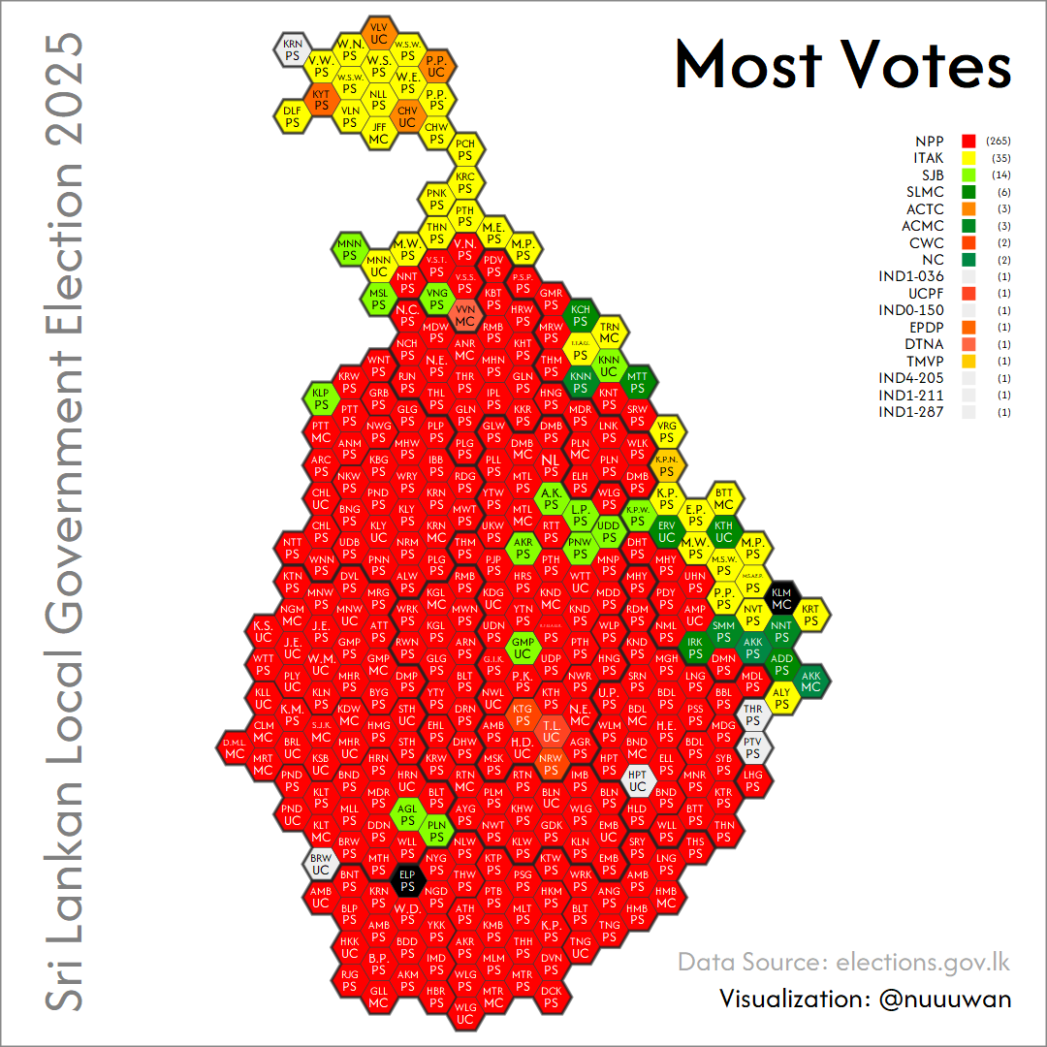
Notes:
In the 2025 Sri Lankan LG elections, NPP dominated, leading in 265 of 339 councils. ITAK topped 35, mainly in the North and East. SJB led in just 16. Fourteen other parties\independents won at least one LG each, highlighting growing political fragmentation. SLPP and UNP saw major declines from previous polls.

Slide 6
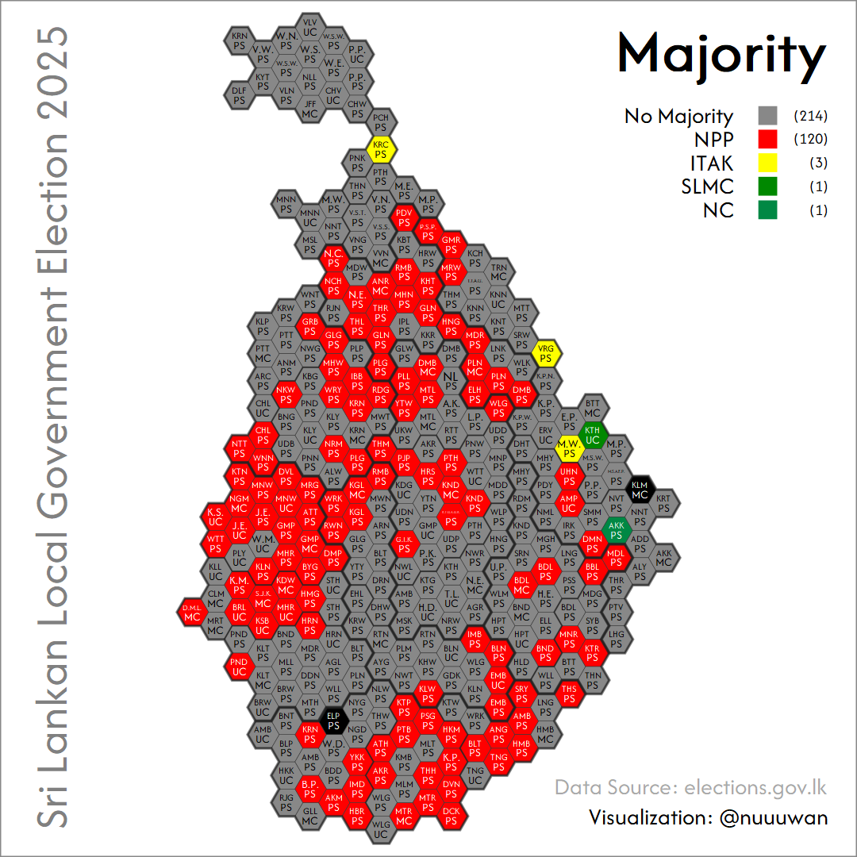
Notes:
NPP won the most votes in 265 LG bodies but secured outright majorities in only 120. The other 145 are hung councils where NPP leads but lacks a majority, needing coalitions or independents to govern.
Out of 339 contested LGs, 214 are hung - highlighting a fragmented landscape. ITAK won majorities in 3, while SLMC and NC secured 1 each.
Sri Lanka's LG elections use a mixed-member PR system: 60% FPTP in wards, 40% allocated proportionally by vote share. Unlike parliamentary polls, there's no 5% threshold or bonus seat for the top party.

Slide 7
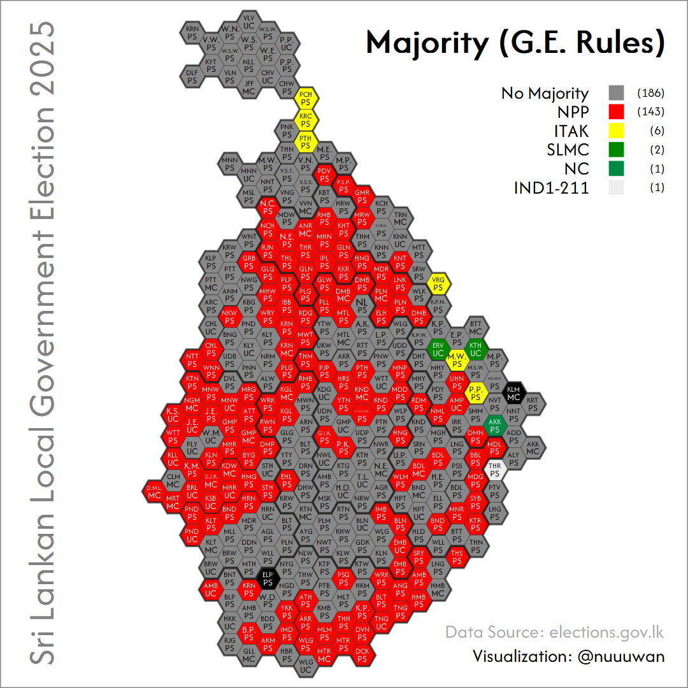
Notes:
If the parliamentary system had been used, NPP would've won majorities in 143 LG bodies, ITAK in 6. Still, 186 LG bodies would remain hung.

Slide 8
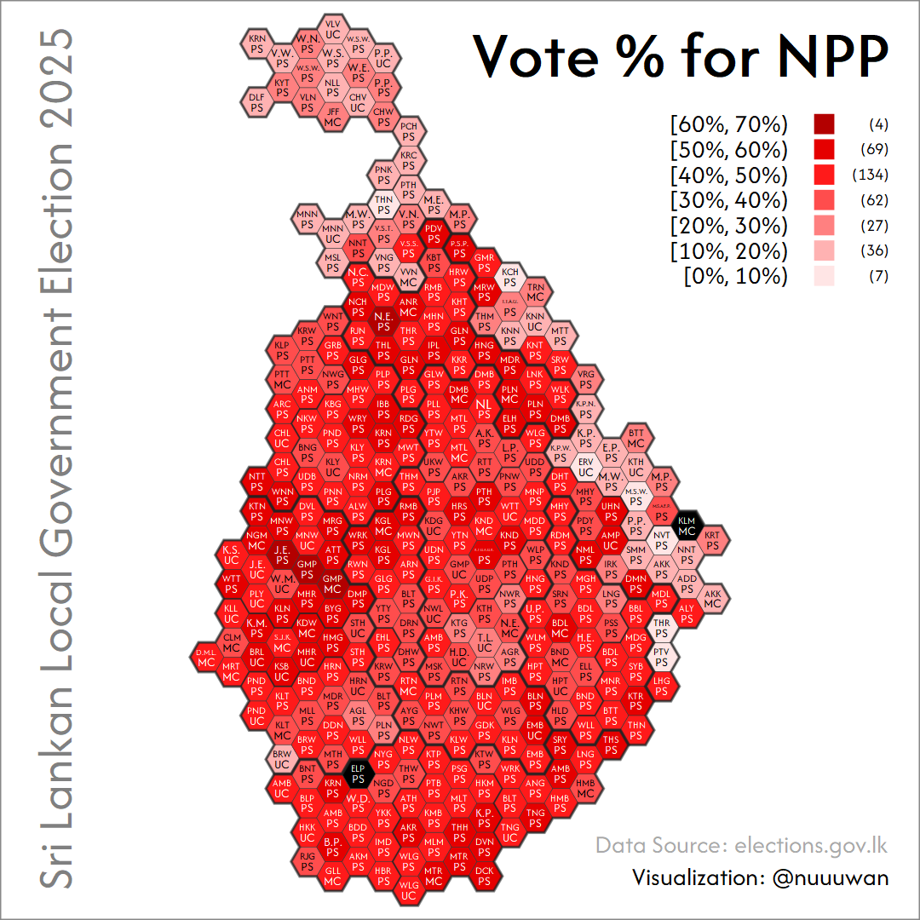
Notes:
The NPPs vote share was similar to its performance in the Presidential Election.

Slide 9
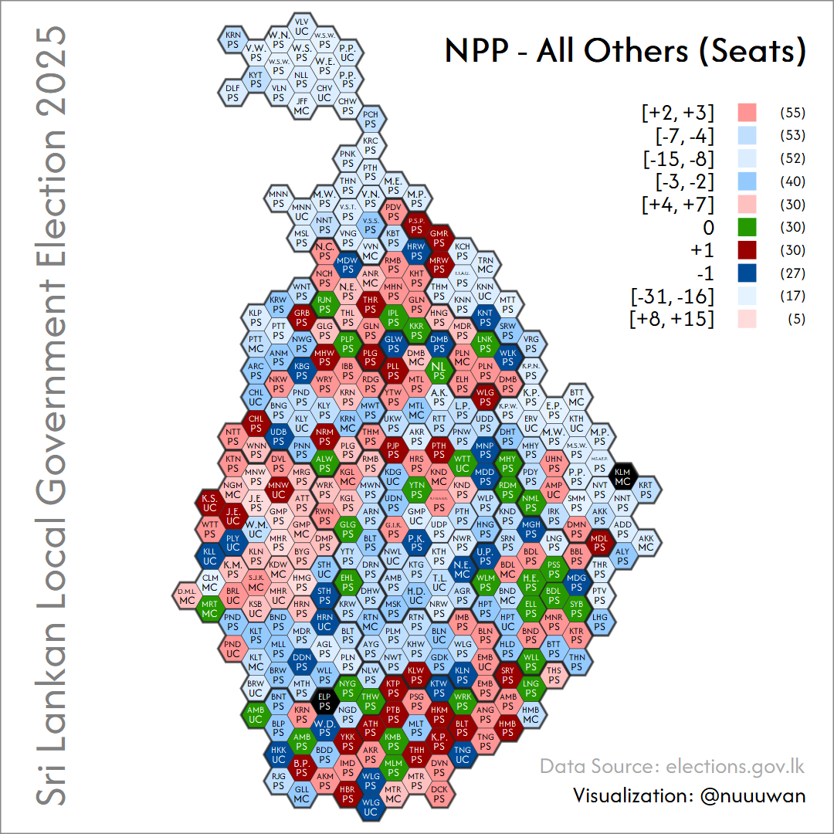
Notes:
What happens to all the Hung LGs?
NPP won outright majorities in 120 LGs. Of these, 30 were by just 1 seat, and 55 by 2–3 seats - making them vulnerable to defections.
In 30 hung LGs, NPP is 1 seat short of control; in 40 others, just 2–3 seats short. These are key targets for post-poll deals or alliances.

Slide 10
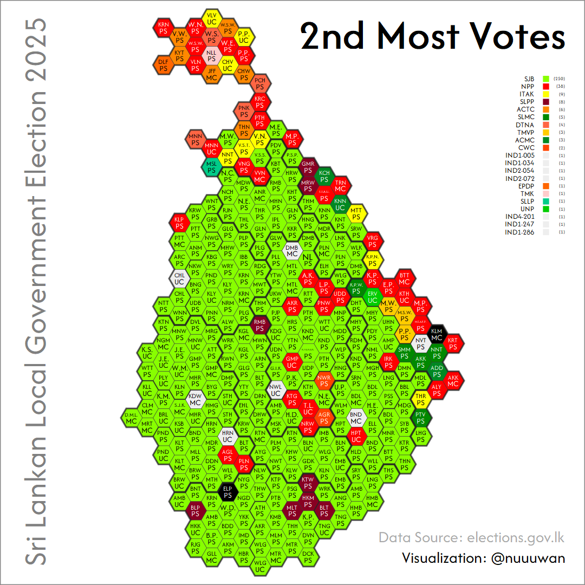
Notes:
The SJB was a distant 2nd
The SJB, Sri Lanka's main opposition party, finished a distant second in the 2025 Local Government election.

Slide 11
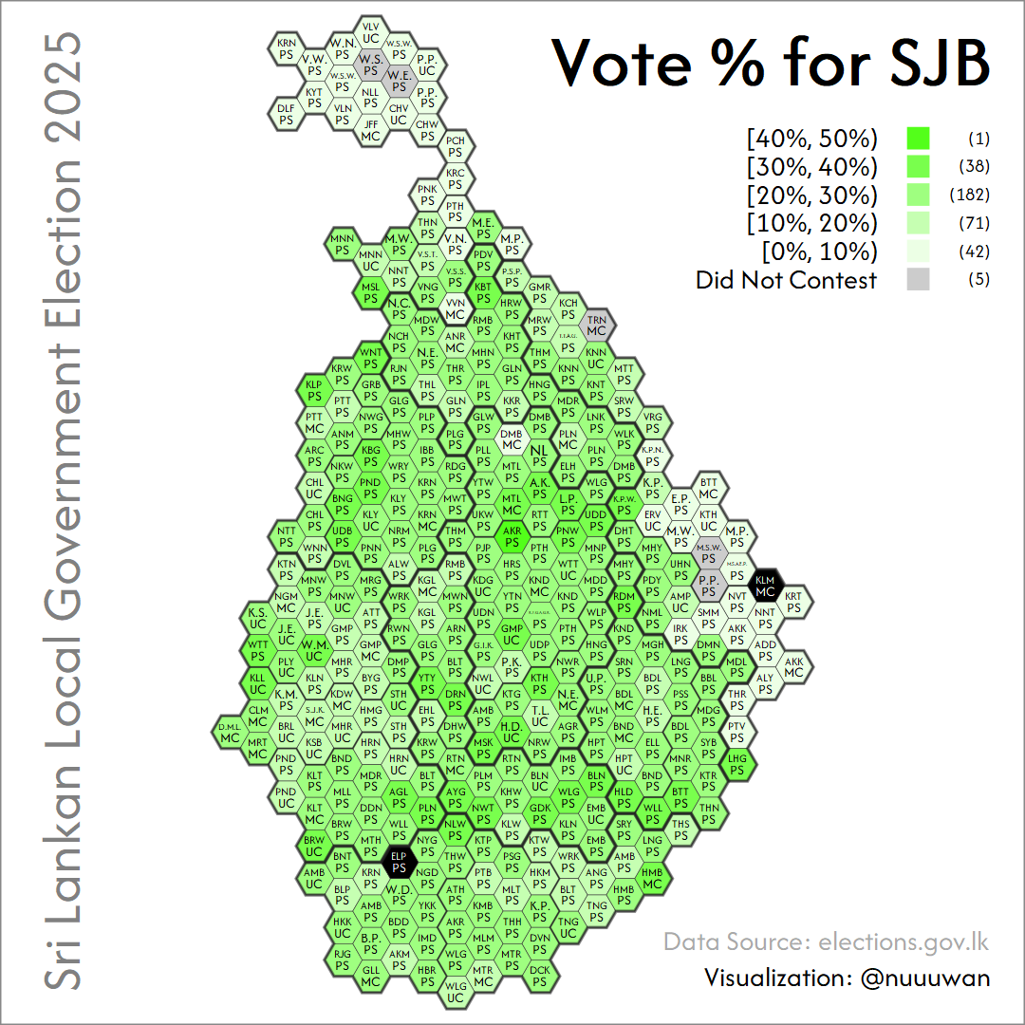
Notes:
It secured between 20% to 30% of the vote in most local authorities - retaining a presence but failing to mount a strong challenge to the NPP.

Slide 12
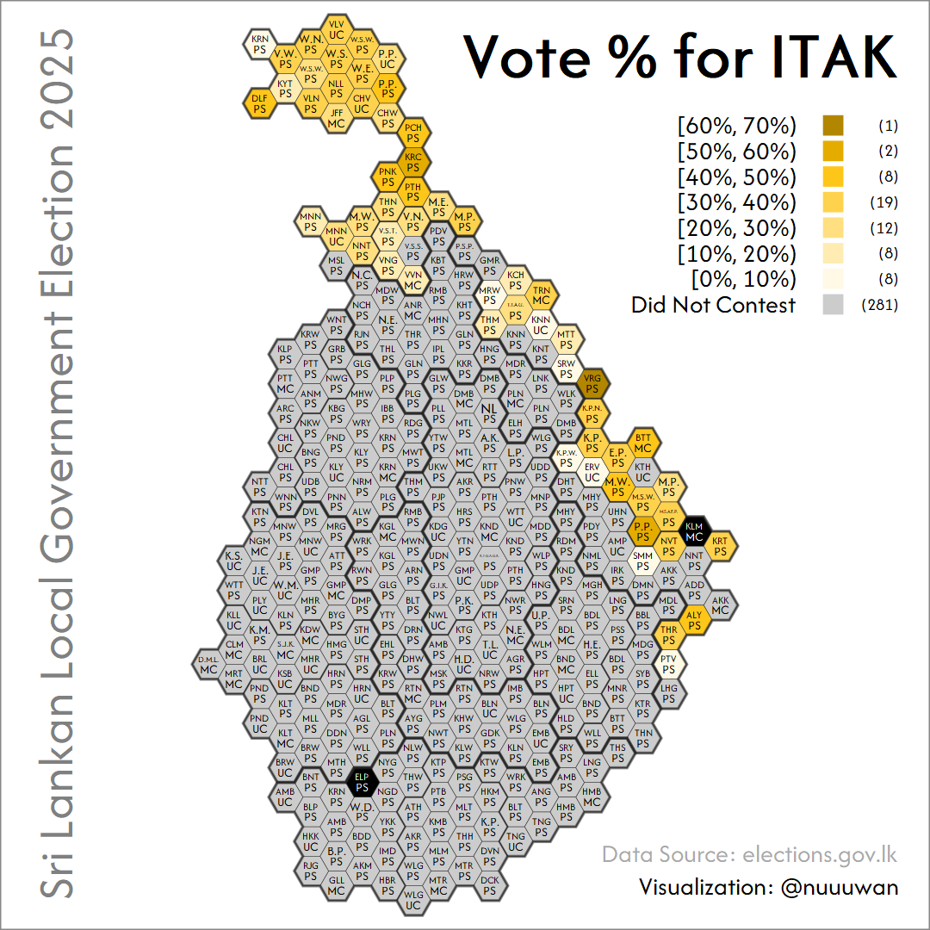
Notes:
Of the 58 LG bodies it contested in the North and East, ITAK won over 50% of the vote in only 3.

Slide 13
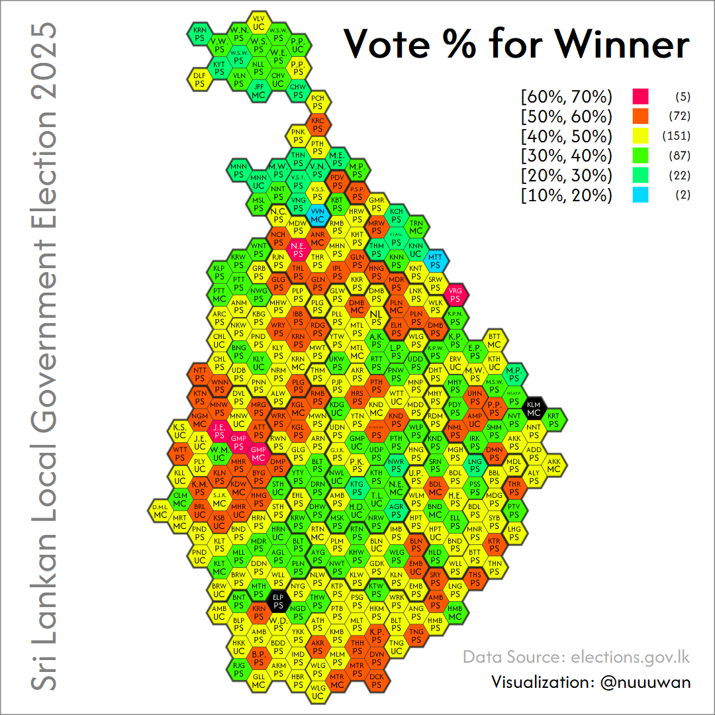
Notes:
While usually the winning party won between 40–50% of the vote, there were many LGs where this number was lower. In 2, the winning party won less thn 20% of the vote.

Slide 14
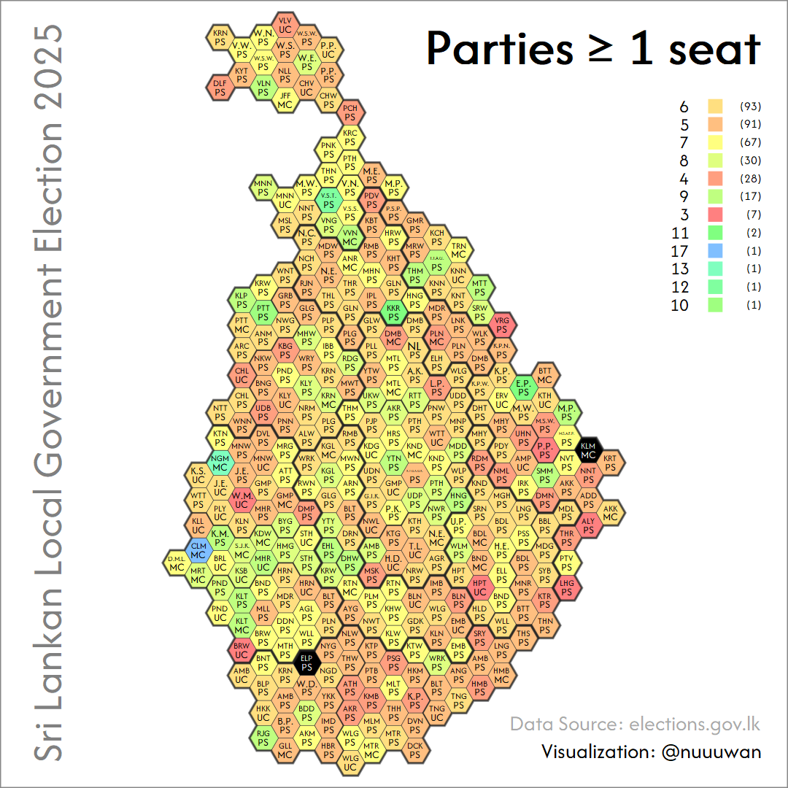
Notes:
In all but 7 LGs, more than 3 parties won at least 1 seat. In all but 35, more than 4 parties won at least 1 seat.

Slide 15
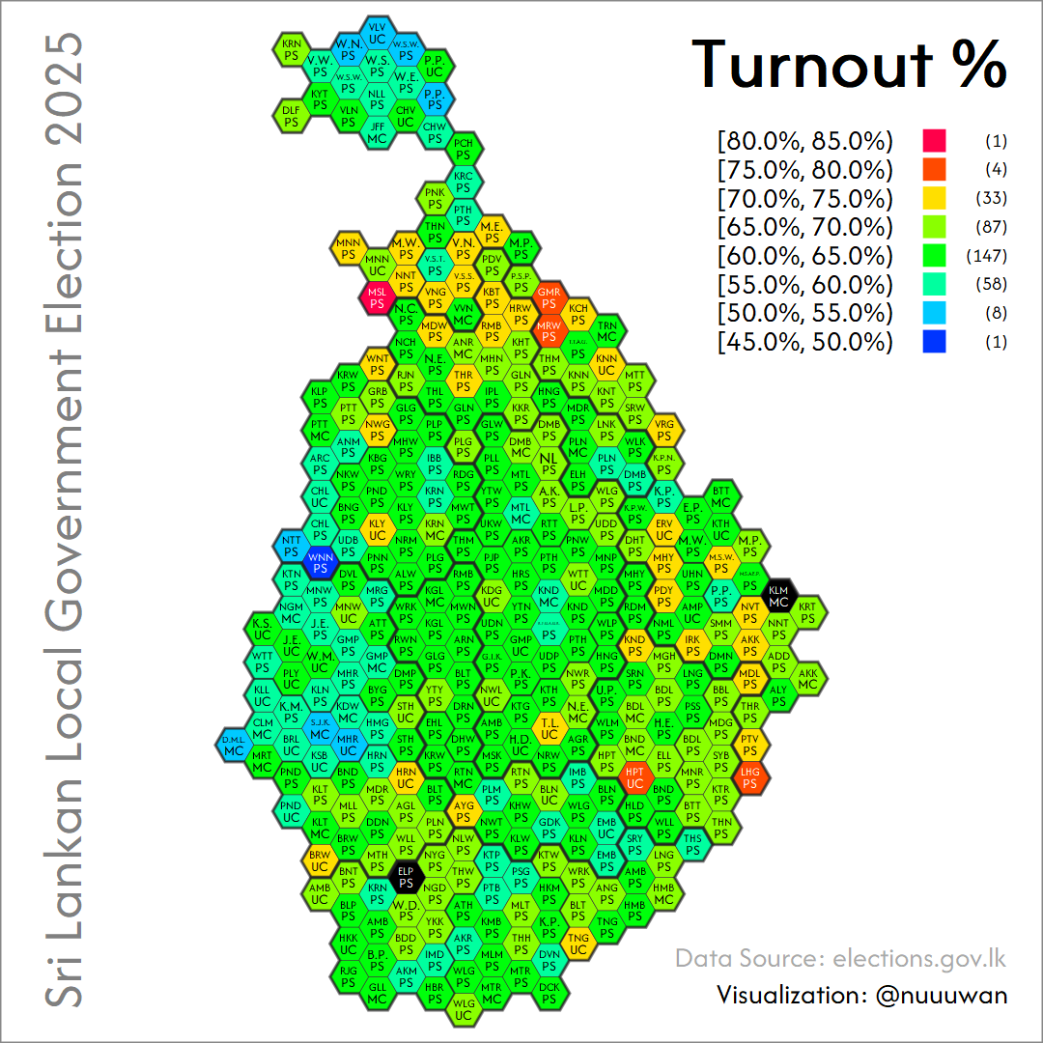
Notes:
Turnout was in line with historical elections, with higher turnout in the Vanni and Eastern Province.

Slide 16
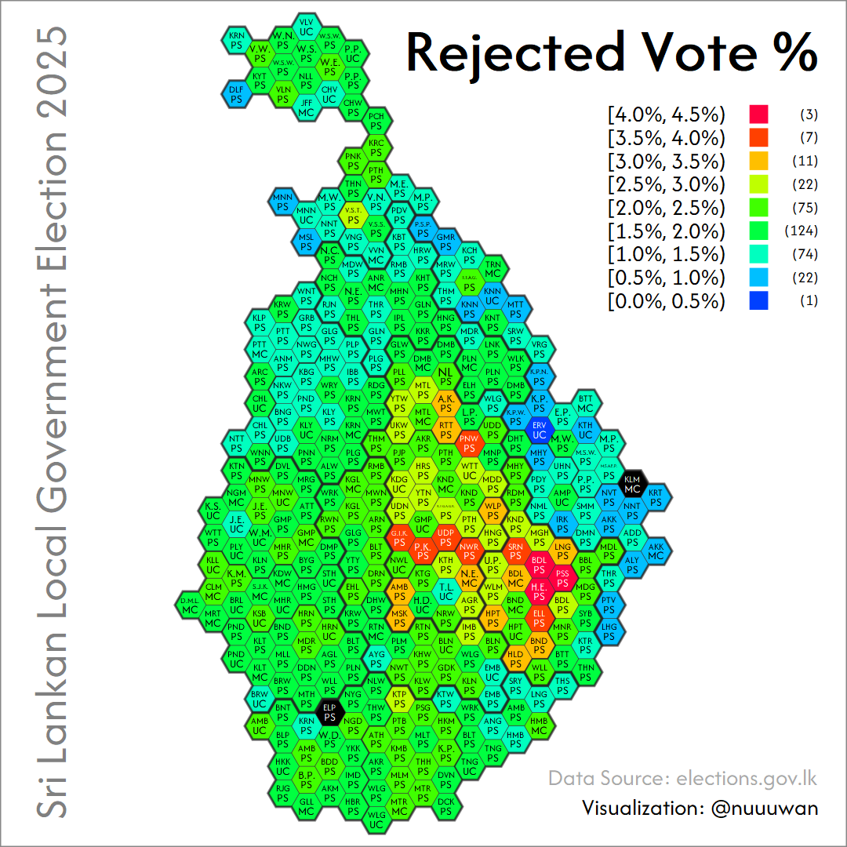
Notes:
Similarly, Rejected votes were highest in the Central and Uva provinces, and lowest in the Eastern Province.

Slide 17
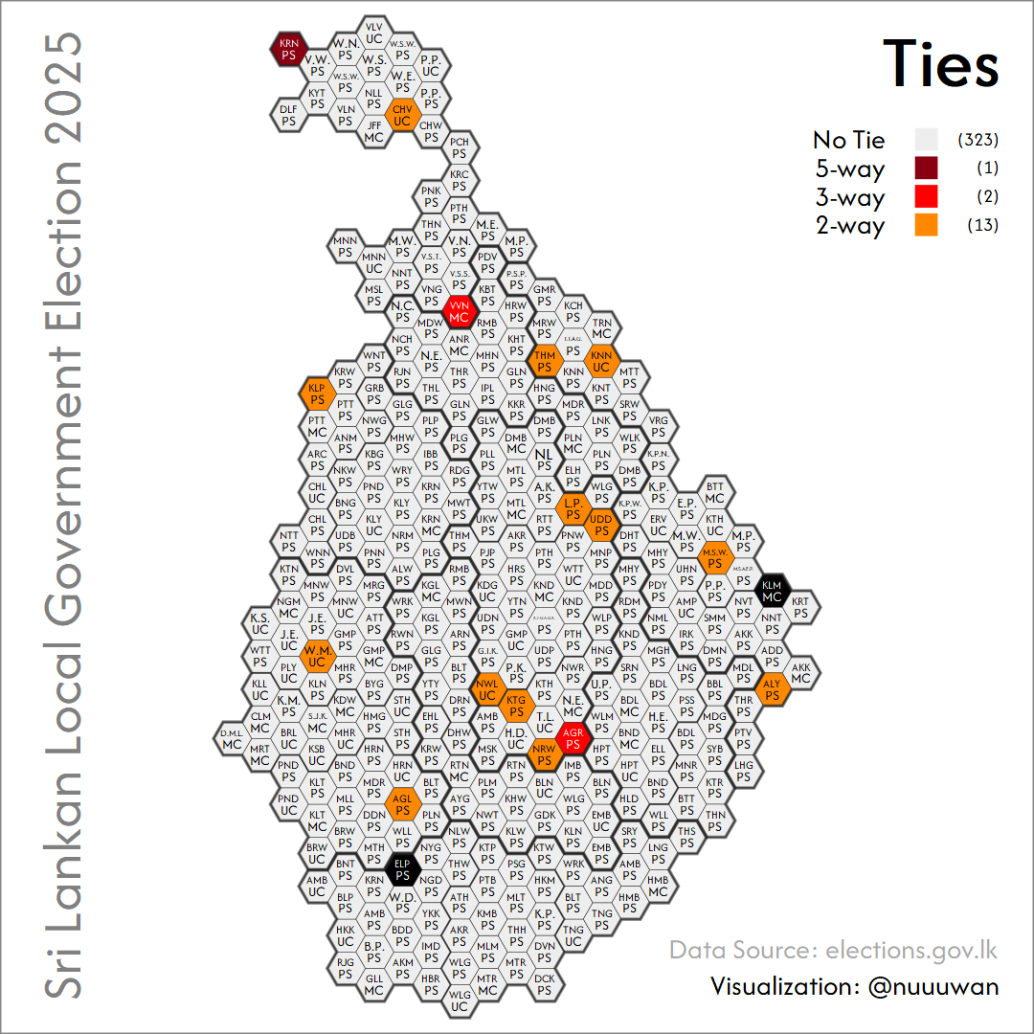
Notes:
There were 13 LGs with two parties tieing for the most number of seats. Another 2 LGs with 3-way ties. And 1 LG Karainagar (KRN) PS with 5-way tie.

Slide 18
Notes:
Usually, the party with the most votes in an LG also wins the most seats. But under the mixed-member system, that's not always the case - in 3 LGs, a party with fewer votes ended up with the most seats.

